Slide 1
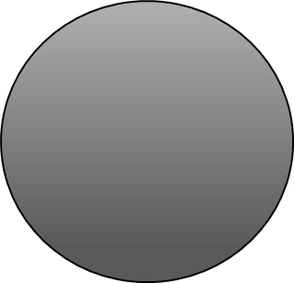


Design and Fabrication of a test rig for CVT Tuning
Pramukh Bharadwaj K.S | Akshith M. H | Raj Purohit | Anish D

Slide 2
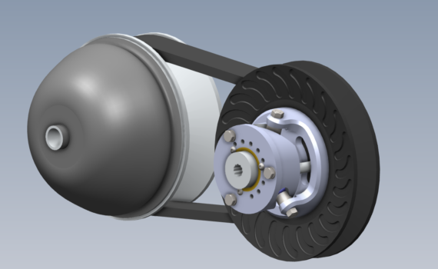
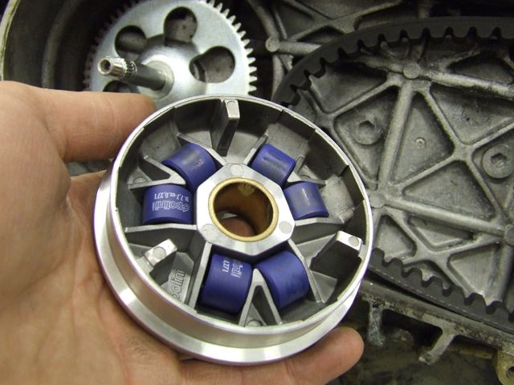
The continuously variable transmission!!
A continuously variable transmission is a type of automatic transmission that has infinite gear ratios and achieves this by varying the diameter of two pulleys.
A CVT has a set of weights at one end that are free to move in one direction. As the RPM varies, the outer wall of the pulley moves outwards or inwards thus changing the effective diameter of the pulleys. The power transmission is done by means of a stepped belt or chains. The minimum and maximum drive ratios define the minimum and maximum change in diameter.

Slide 3
Tuning it!!
Testing, Tuning and effective optimization is an essential part of any system for it to perform to its maximum potential. Likewise a CVT has to be tuned for optimum performance as per the requirement in real life conditions.
Tuning in a CVT refers to altering and adjustment of the various parameters to ensure smooth function. Some parameters that can be varied are weights and their distribution, spring parameters, engagement RPM , shift RPM etc. Optimizing all these parameters ensures that the engine remains in its peak power band and providing enough torque for translation, while still trying to maximize efficiency.
Here we aimed to pair it to the standard Briggs and Stratton engine, use an IR sensor for RPM measurement and Rope brakes for simulation of road load.

Slide 4
What is a Test Rig ?
A set-up used to test the performance of a product by simulating practical conditions before full scale use of the product.
In the absence of a test rig, CVTs cannot be tested in the workshop. For testing, they must be installed on the car and the car has to keep running to evaluate parameters. In case something must be changed, the entire set-up must be removed from the car to make the necessary changes and again installed on the car for further testing. This is a tedious process and takes time. Also, evaluating the instantaneous parameters of a running CVT while on the car that is in motion is not an easy task. Thus a test rig set-up makes all these processes simpler.

Slide 5
The Rope brake
The rope brake consists of a rope wound around a drum and tied at both ends with weights and a spring balance.
The rope is pulled tight by means of screws. The friction generated between the drum and the rope simulates load/resistance. Since friction generates heat this system requires cooling (usually water cooled)
The force is given by taking the difference of the spring balance reading and the weights on the other side.
Net Force F= W-S
Braking Torque= F x R (Nm)
Power absorbed by the engine P = (2 x ∏ x n x F)/(60 x 1000) kW
Where,
W- Dead weights
S- Spring balance reading.
R – effective radius ( drum + rope)
n- RPM of the engine.

Slide 6
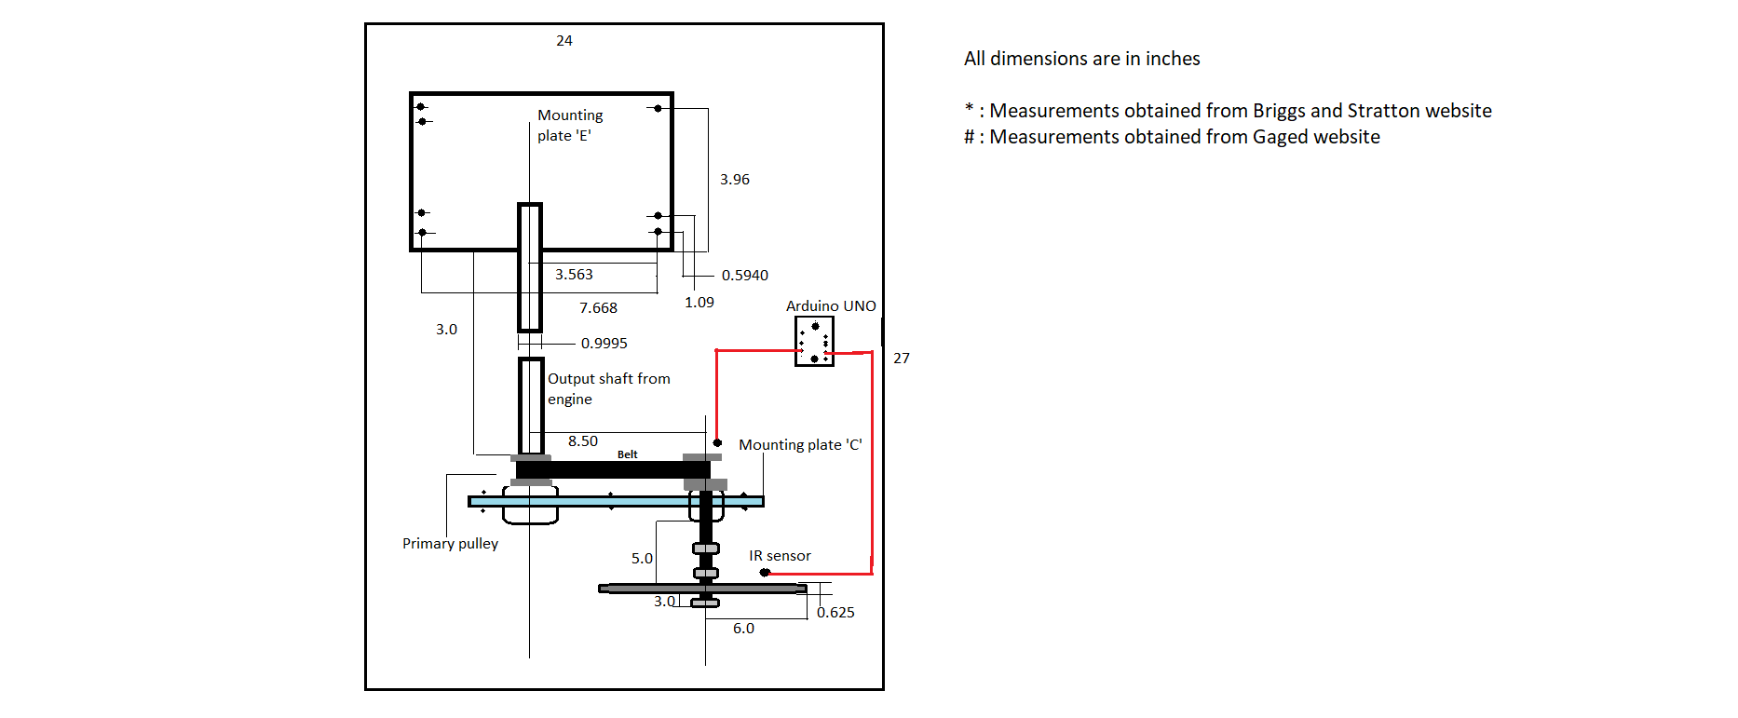
The Design and layout

Slide 7
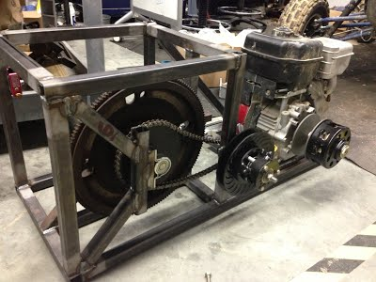
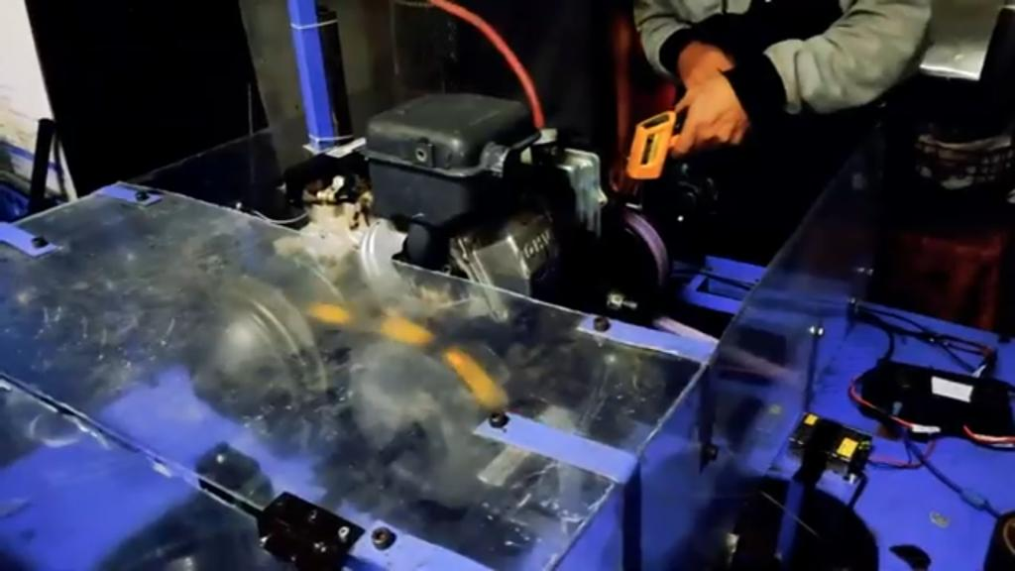
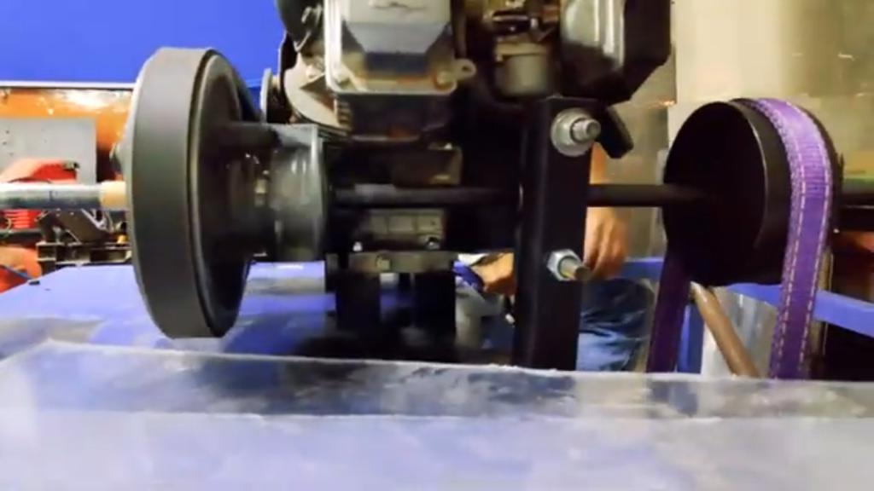
The Journey!!
In the initial week, we studied a little about CVTs and how they work. We also looked at papers written by other university students about the procedure of tuning CVTs and the testing setup used by them.
We also looked at various sensors that can be used to measure RPM and finalized the IR sensor as it suited the current requirements the most.
Various Other set-ups

Slide 8
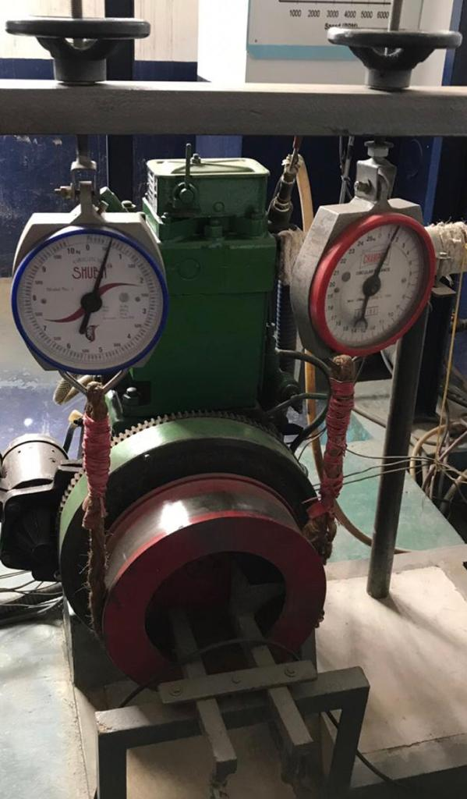
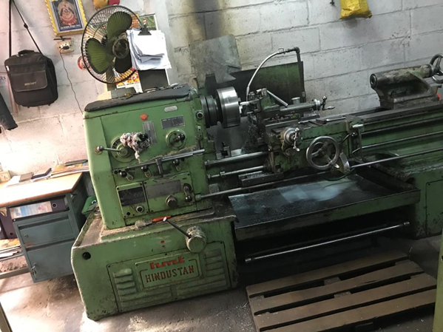
The Journey!!
In the following weeks, we began collecting materials from around the workshop.
Thanks to our mentors who suggested that we could use the scrap frame and sheets lying around to make the base, and they also introduced us to the Rope brake set-up in the lab, that we have used to simulate road load conditions.
Following it we used a scooter wheel rim for the Rope brake drum.
As we encountered small hiccups about the drive shaft from the gearbox fitting into the rim, we had to seek the help of a lathe and a bench drill to ensure perfect fitment.
The Set-up in the Mechanical lab

Slide 9
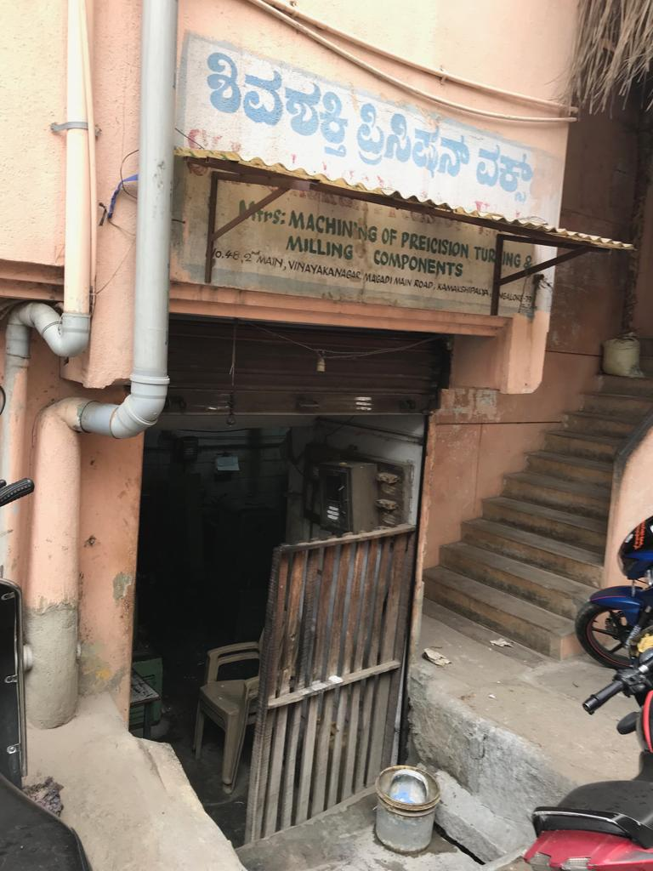
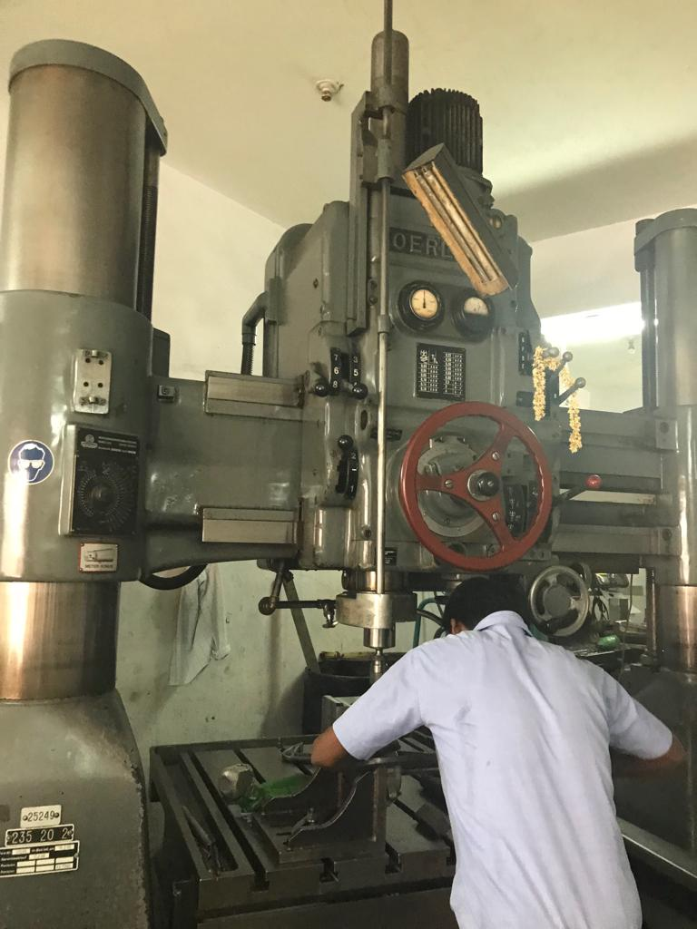
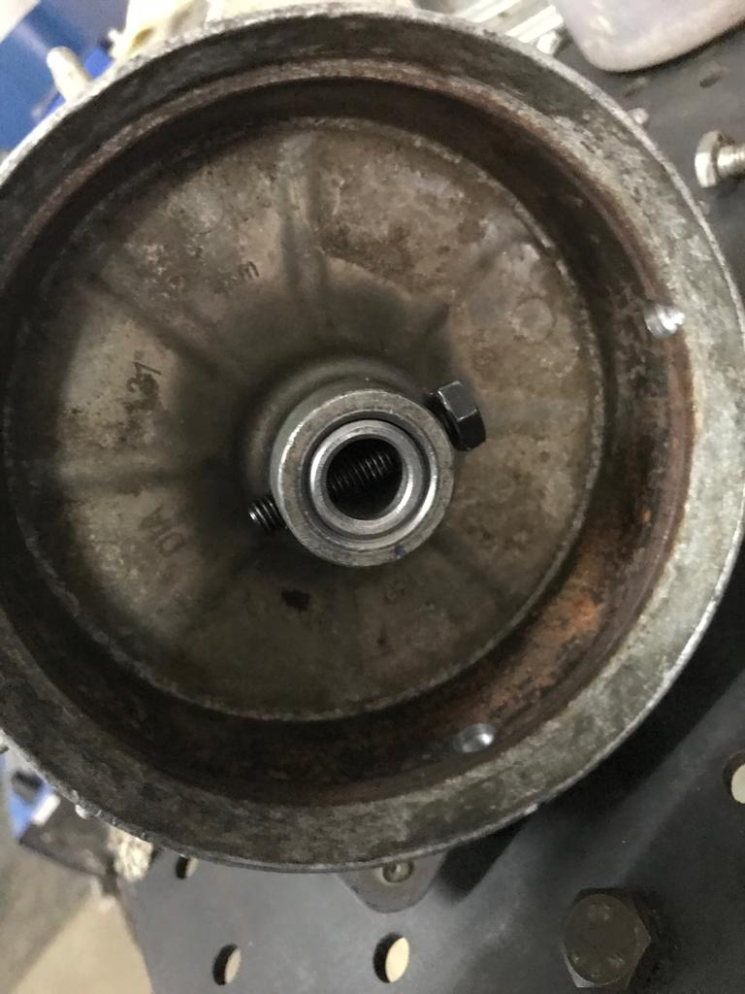



KAMAKSHIPALYA
THE END RESULT!!

Slide 10
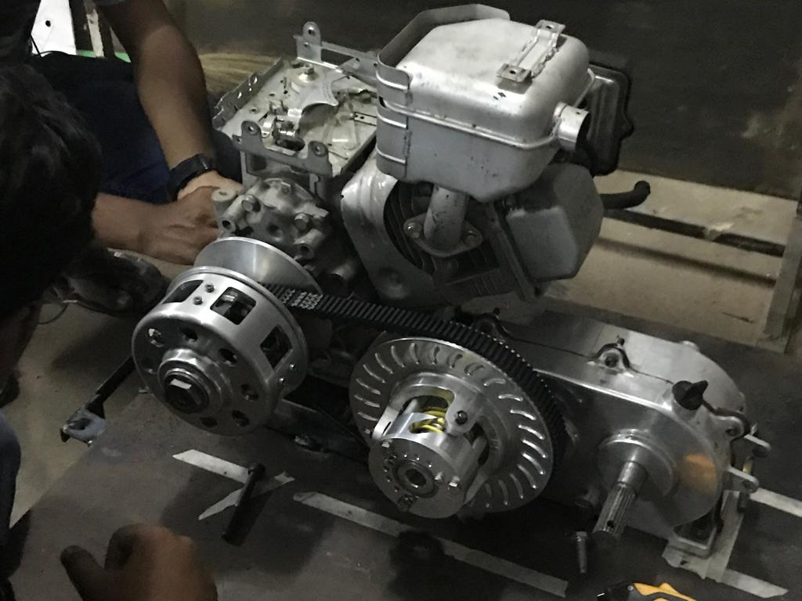
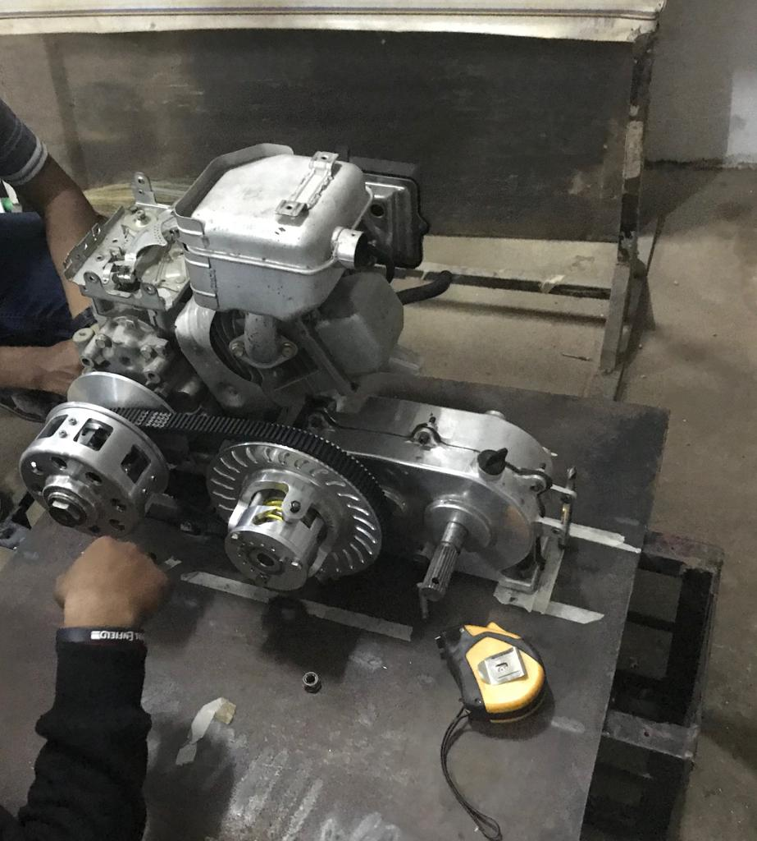
The Final stage

Slide 11
We sincerely thank the team for giving us this wonderful opportunity.
Special thanks to our mentors Somanna, Jayanth and Shrikara for helping us reach this far!
THANK YOU!!!

